Slide 1


Exploration of Reinforcement Learning in Computer Games
Jiajing Guan, Patrik Gerber, Elvis Nunez, Kaman Phamdo
Academic Mentor:
Tonmoy Monsoor
Sponsoring Mentors:
Nicholas Malaya, Abhinav Vishnu, Alan Lee

Slide 2

Advanced Micro Devices
Develops high-performance semiconductors
Provides computer processors and related technologies for business and consumer markets
Interested in edge-inferencing in autonomous vehicles, robotics, manufacturing, and smart grids
Notes:
Semiconductors: microprocessors, motherboard chipsets, graphic processors
Interest: edge inference is infer results of new data from trained network, performed locally in embedded platforms that have limited area and power budget

Slide 3
Overview
Introduction
Tabular Q-Learning
Deep Q-Learning
Intermediate Results
Further Work

Slide 4
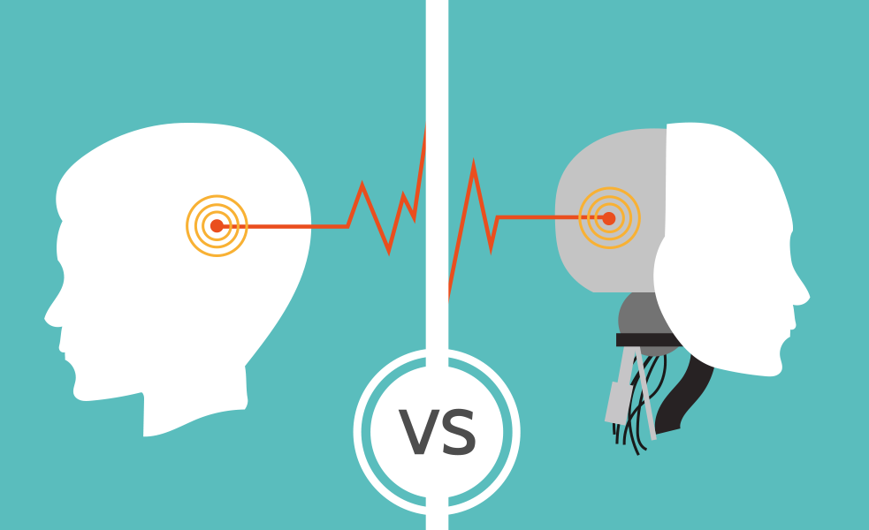
Motivation
Notes:
Supervised learning: training, human labeled data

Slide 5
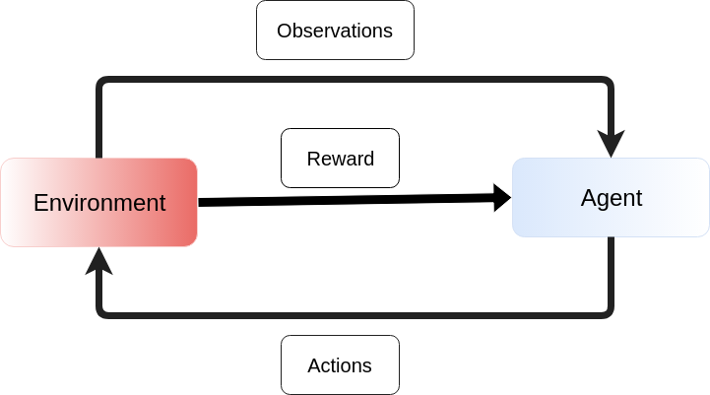
Reinforcement Learning
Goal: select actions that will maximize expected future reward

Slide 6
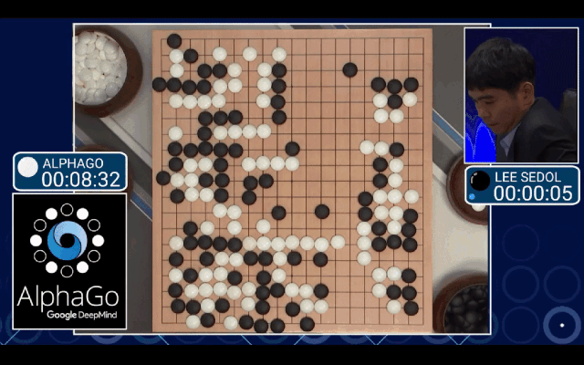
Superhuman performance
Lee Sedol losing a game to AlphaGo in 2016

Slide 7
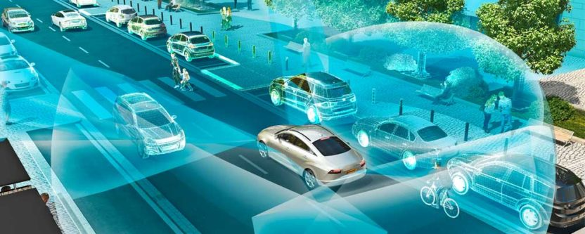
Problems Identified
Unable to achieve superhuman performance across the board
Require huge amounts of training time and experience
Not robust to perturbation in environments

Slide 8
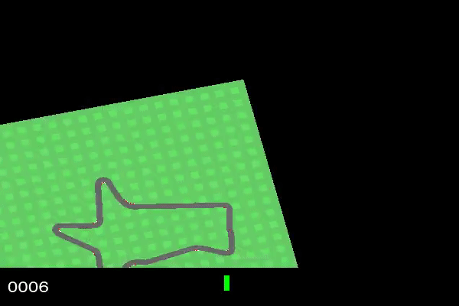
Why Computer Games
Use computer games as a sandbox to investigate the sensitivity of reinforcement learning algorithms
Well-defined rules
Easy to collect data
Easy to create perturbations
Car Racing game
Applicable to autonomous cars

Slide 9
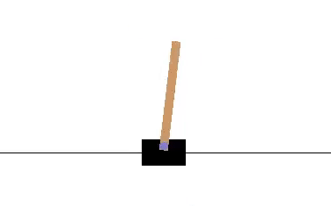
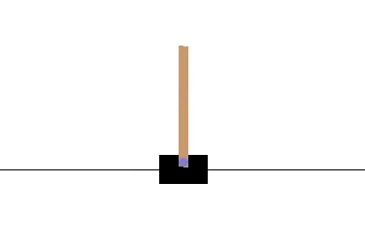
Cart Pole
At the beginning of the training
By the end of training
Notes:
Will use the game Cart Pole as a running example throughout the talk
The ‘cart’ (black box) can move left or right along the x axis (black line)
The pole balances on top of the cart
The goal is to move the cart left and right so that the pole remains balanced
The game ends when the pole is more than 15 degrees from the vertical
Our goal is to train an agent to play this game successfully: correctly tell us when to move left or right

Slide 10
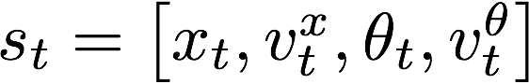
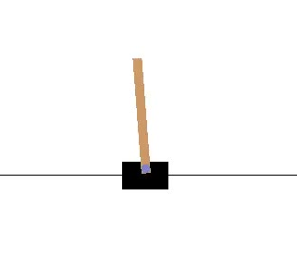
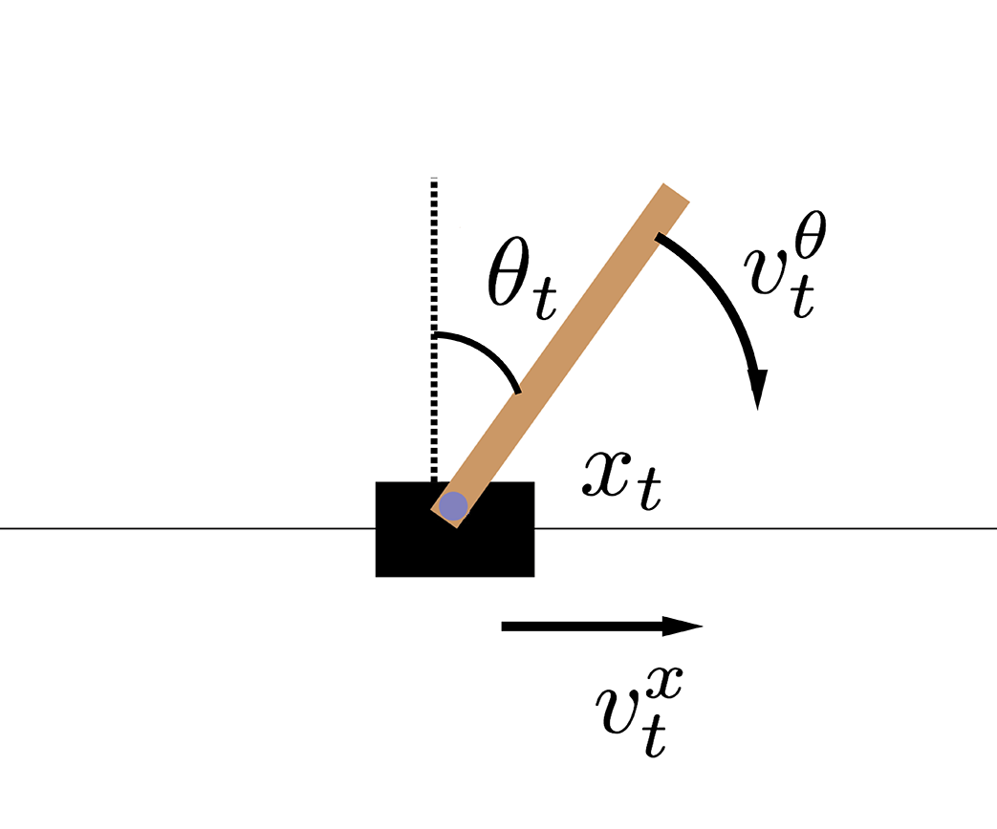
Cart Pole Reinforcement Learning Diagram
Observations:
Agent
Environment
Reward: +1 for every time step
Actions: Left/Right
Notes:
Continuous space

Slide 11
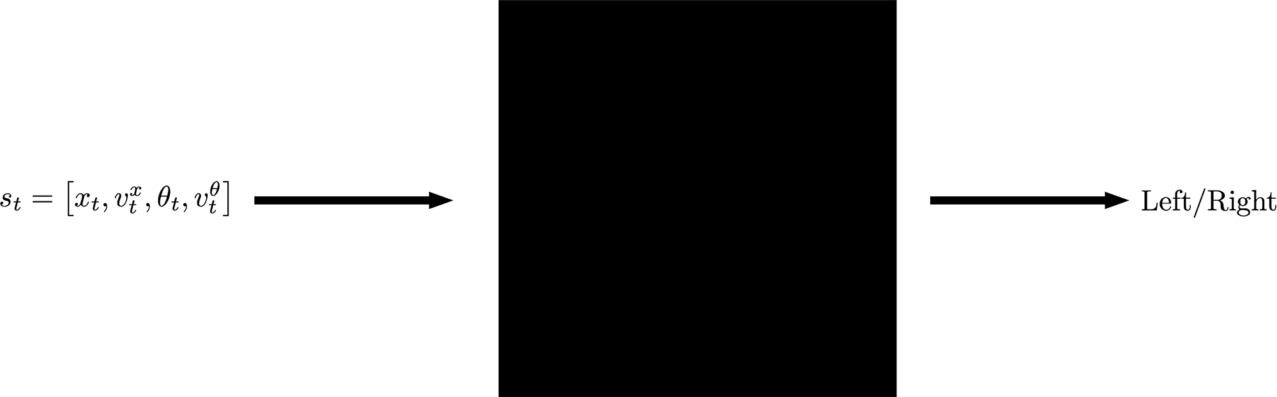
Goal
Determine optimal action given current state of game
Notes:
Black box representation: Take state, perform some operations on it, output if the agent should move left or right
The purpose of our project is to develop this black box that is robust enough to adapt to changes in the environment

Slide 12
Overview
Introduction
Tabular Q-Learning
Deep Q-Learning
Intermediate Results
Further Work

Slide 13
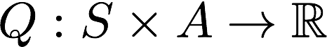
Q-Learning
Let S be state space, and A be the action space
Define function Q(s,a) that measures how “good” it is to take action a given the agent is in state s
Notes:
As the black-box diagram suggested, we would like to have some way of determining which action to take when we are at some state.
Suppose we have some function, Q, that will tell us how “good” it is to take some action at some state

Slide 14
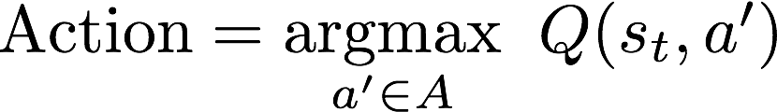
Q-learning
Use Q to determine action at state s_{t}
Notes:
If we had such a Q…
Then to choose the next action we will evaluate Q(s_t, …) at all possible actions and choose the action with the largest Q value

Slide 15
Q-learning
How to define Q to capture “goodness” of a state-action pair?
How is Q represented?
Notes:
How do we define Q so that we can quantitatively say that one action is better than another
Moreover, how can we define Q so that the agent can learn it
We will first address how Q determines if an action is “good”

Slide 16
Reward
After taking an action, agent will receive a reward R_{t+1}
Received reward may be immediately good, but action may lower potential future rewards
Q(s_{t} , a_{t} ) should represent the expected long term reward after taking action a from state s_{t}
An action is “good” if Q(s_{t} , a_{t} ) is large
Notes:
To do this we introduce the notion of a reward
After every action, the agent will receive a reward which will reflect whether the action was (immediately) favorable; in short telling the agent what we want it to achieve
- While immediate rewards may suggest an action is favorable, we need to consider how the action affects future rewards as well
- We need to define Q in such a way so that when we evaluate Q(s_t, a_t) , this represents the expected long-term reward after taking action a_t from state s_t
- In short, an action will be considered “good” if it has a large expected long-term reward

Slide 17
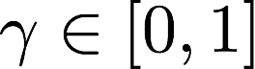
Discounted Rewards
Discount factor:
Optimal Q:
Notes:
So far we’ve assumed we had this function Q that tells us the next best action
In reality, we don’t have it. We initialize it randomly and let the agent play the game and learn Q
Q* represents the Q that we want and that we want to obtain after training
As suggested in the previous slide, Q* is defined to capture expected long-term rewards

Slide 18
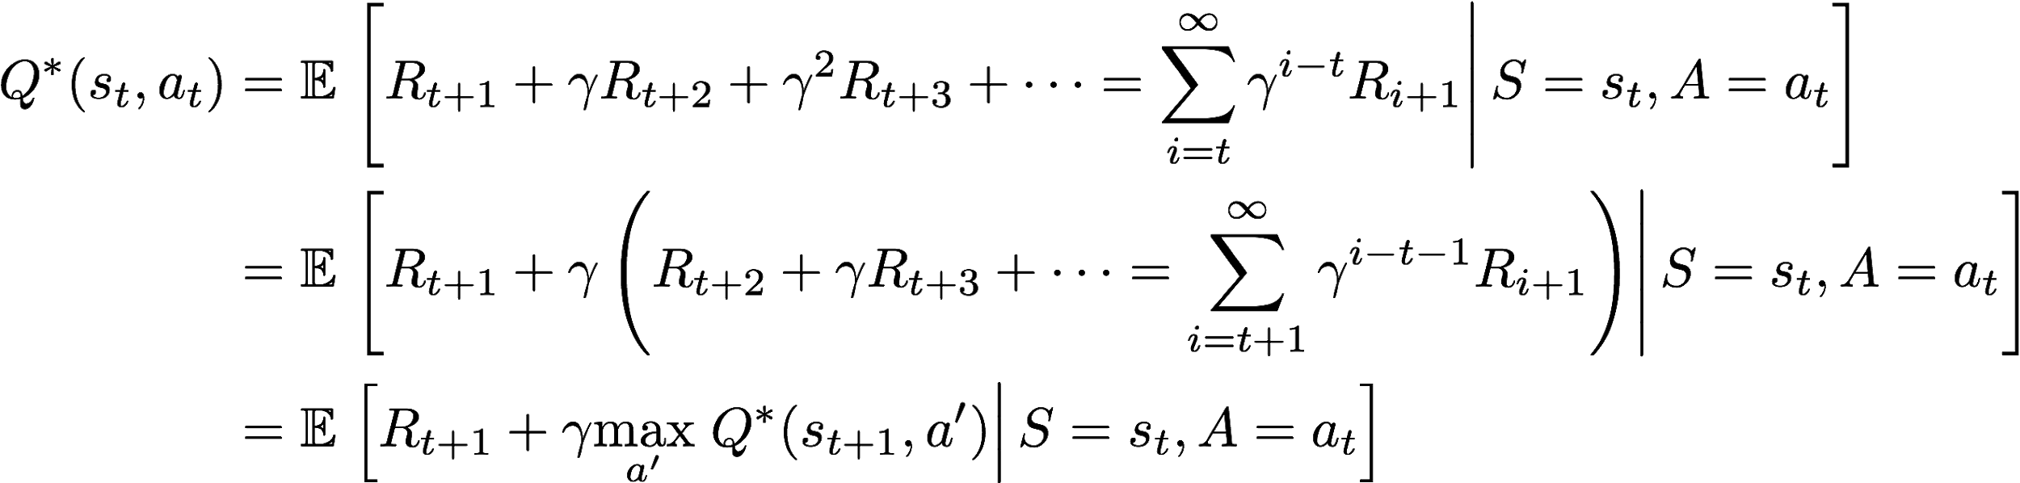
Bellman Optimality Equation
Q*(s_{t} , a_{t} ) satisfies Bellman optimality equation
Notes:
By factoring and applying the law of total expectation, we see that Q* satisfies an optimality identity known as the Bellman equation
Ultimately, we now have a recursive definition for Q*, allowing us to easily obtain an iterative update for our estimate of Q*

Slide 19
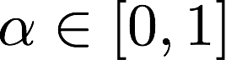
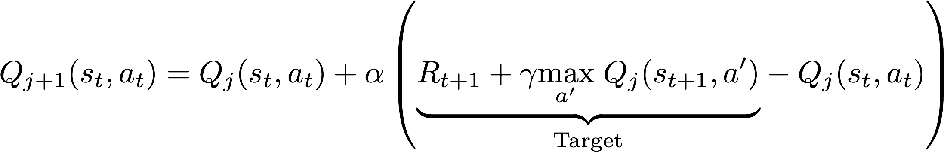
Iterative Update
Learning rate:
Iterative update:
Notes:
We will introduce a parameter, alpha, to control “how much” we want to update Q at each iteration; in other words, how much weight we want to give to the update
To update Q, we want something of the form Q_{j+1} = Q_{j+1} + alpha*error.
Target value represents what we think Q should be (at the current iteration) based on the Bellman equation
As j -> infinity, error -> 0

Slide 20
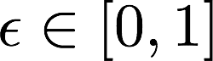
Exploration vs. Exploitation
Initially, Q(s_{t} , a_{t} ) is not accurate
To improve Q, need to explore state space
Take random action with probability
As Q improves, epsilon may decay
Notes:
One more thing...
Q is initialized randomly, so immediately taking actions suggested by Q will introduce bias towards the initialization
To remedy this, introduce parameter epsilon so that on each iteration, with probability epsilon we take a random action and with probability 1 - epsilon take action suggested by Q (exploration)
Over time, take actions suggested by Q (exploitation)

Slide 21
Q-learning
How to represent Q?
Two ways: tabular and neural network
Notes:
We’ve talked about the theory of Q and how we want it to behave
How do we actually implement this? Also, Q is a function… how does a computer learn a function?
2 ways of representing Q: as a table and as a neural network
We will first go over the tabular representation

Slide 22
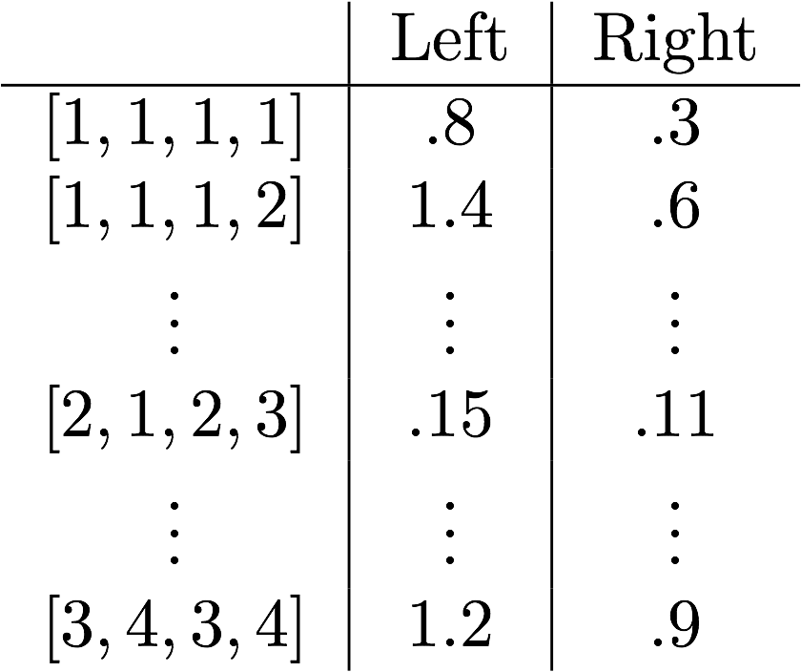
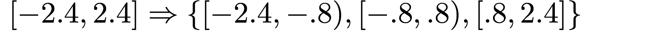
Tabular Q-learning
Represent Q as a lookup table
Discretize state space
Notes:
In this setting, we will store Q as a look-up table
Most games have a continuous state space (as seen above for cart pole). Since we have finite memory, we cannot store the value of Q for every possible state-action pair
To remedy this, we discretize the state space into disjoint bins

Slide 23
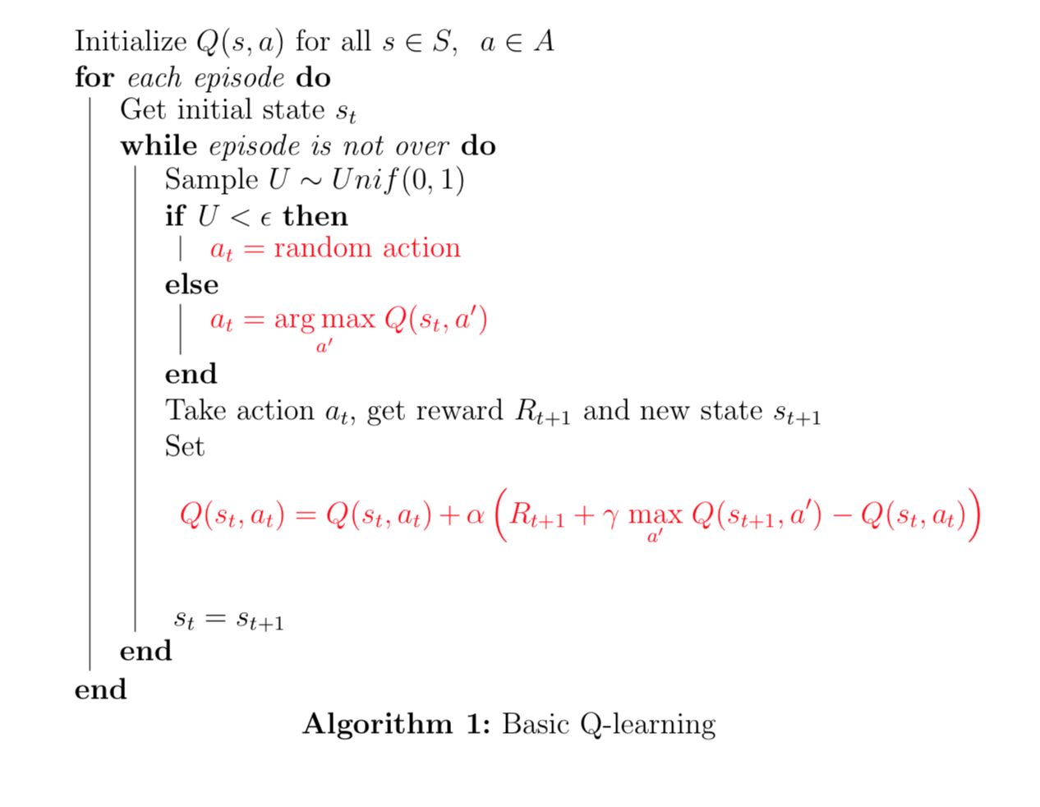
Tabular Q-learning Summary

Slide 24
Drawbacks of Tabular Q-Learning
In more complex games, images are used to represent the state of the environment
Representing Q as a look-up table becomes infeasible
This is why we use Deep Learning
Notes:
The tabular representation of Q does not generalize well to games with large state spaces
The states of some games are images. And, if we consider a grayscale image with 1000 pixels, there are 256^1000 possible states
In this case, representing Q as a look-up table is infeasible
Instead, we will represent Q as a neural network

Slide 25
Overview
Introduction
Tabular Q-Learning
Deep Q-Learning
Intermediate Results
Further Work
Notes:
We’ve seen tabular Q-learning, now we move onto Deep Q-learning.

Slide 26
Deep Q Network (DQN)
Q is just a function
We approximate this function with a neural network, called the Q-network
Notes:
As Elvis explained, Q is just a function, so we could use any function approximator we like to represent it.
Recently however, neural networks have been shown to work well in some applications, thus a lot of the current work is being done using Neural Networks as approximators to Q.
If we do exactly that, approximate Q by a neural network, we arrive at the Deep Q-learning algorithm (DQN).
We call the resulting network the Q-network, and it takes as input a state and a possible action in that state, and outputs a value that estimates the ‘goodness’ of taking that specific action in the given state.

Slide 27
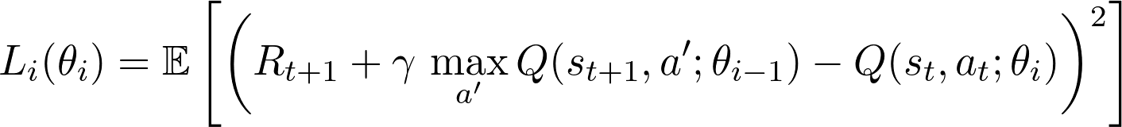
Loss function
Goal: Find weights θ that minimize loss function
Problem: Can’t evaluate the expectation because the dynamics of the environment are unknown
Solution: Online/Stochastic Gradient Descent
Notes:
When we talk about deep learning and neural networks, there is always some kind of loss function involved that we aim to minimize. In supervised learning the setting is very simple, we have a training set and labels, and the loss is some function of this data.
In reinforcement learning however, there is no training set or labels, we need to learn using our own experience from playing the game.
Usually online algorithms are used, where we adjust the weights of our network at each timestep.
The loss for DQN is the mean squared TD-error, which comes from the Bellman optimality equation.
Note that in the absence of supervision, we need to bootstrap using our current parameter estimates, as in the simple Q-learning case. We will actually get back to this, as it turns out that this naive bootstrapping can prevent convergence of the model.
But how do we minimize this loss function? We can’t evaluate the expectation, since we don’t know the dynamics of the environment. The solution is to use Stochastic Gradient Descent, an online gradient-based optimization method.

Slide 28
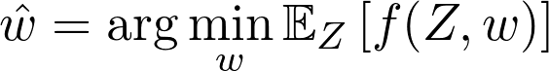
Stochastic gradient descent (SGD)
There are multiple formulations, but the main idea is:
Consider the following minimization problem where the distribution of Z is unknown:
Given an iid sample from the distribution of Z, Stochastic Gradient Descent performs the following online update:
Notes:
Consider the case where we try to minimize the expectation a function f of a random variable Z of unknown distribution that is parametrized by w.
Assuming we can sample from the distribution of Z, Stochastic Gradient Descent allows us to perform this minimization online, using the simple update rule shown *here*.

Slide 29
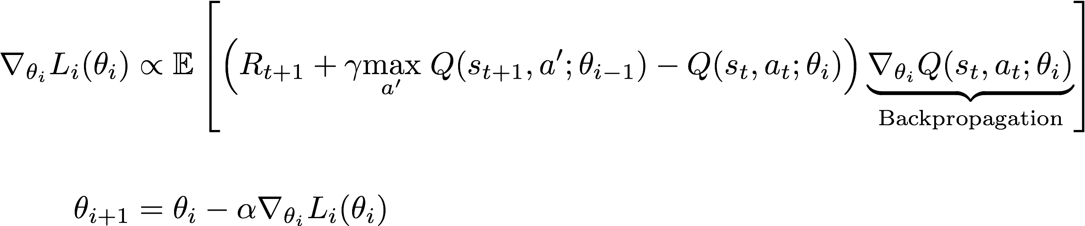
Minimizing the loss
Goal: Find weights θ that minimize loss function
Find optimal weights iteratively, using one step of Stochastic Gradient Descent at a time
Notes:
Back to our loss function, differentiating it WRT the weights, we get *this* expression.
The SGD update rule becomes *the one shown* in this case.

Slide 30
Minimizing the loss
Problem: SGD assumes independence
Solution: Use experience replay to decorrelate the samples generated by gameplay
Notes:
Okay so we’ve found a way to minimize the loss function, given some independence assumptions. Are these assumption reasonable?
As we’re playing the game, and updating the weights of Q as we go, we’re visiting a sequence of highly correlated states, by the nature of how videogames work.
We need to somehow decorrelate these transitions, in order to achieve convergence. The method of experience replay does exactly that, and it works as follows.

Slide 31
Experience Replay
At each timestep, store the state, action, reward and new state in the ‘replay memory’
Instead of updating parameters of Q-network based on most recent experience, use experience from the past, uniformly sampled from the replay memory
Notes:
At each timestep, we store the experienced transition - i.e. the tuple state, action, reward, next state - in the replay memory that we denote by D.
Then, instead of updating the weights using our most recent experience, we update it based on past experience, sampled uniformly from the replay memory.

Slide 32
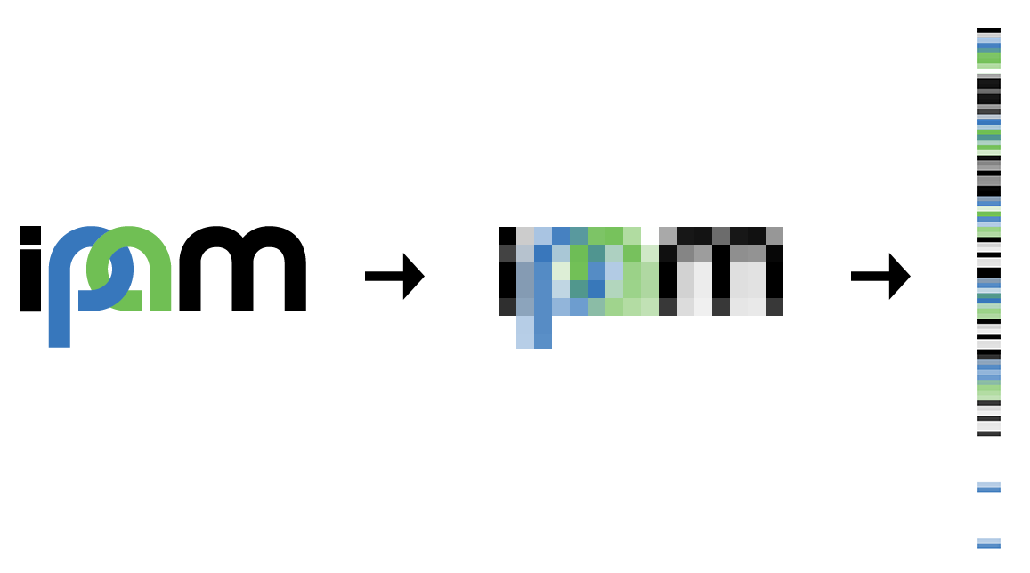
Deep Q-Learning In practice
Question: How do we represent the state s?
At each timestep, process the RGB image from the screen the following way
Take previous 3 and the current frame
Downsample and convert to grayscale and stack all 4
Notes:
So we’ve seen why we need Deep Q-Learning, and how we would train such a model. But we didn’t discuss the agent’s internal representation of the state it is in.
Explain preprocessing

Slide 33

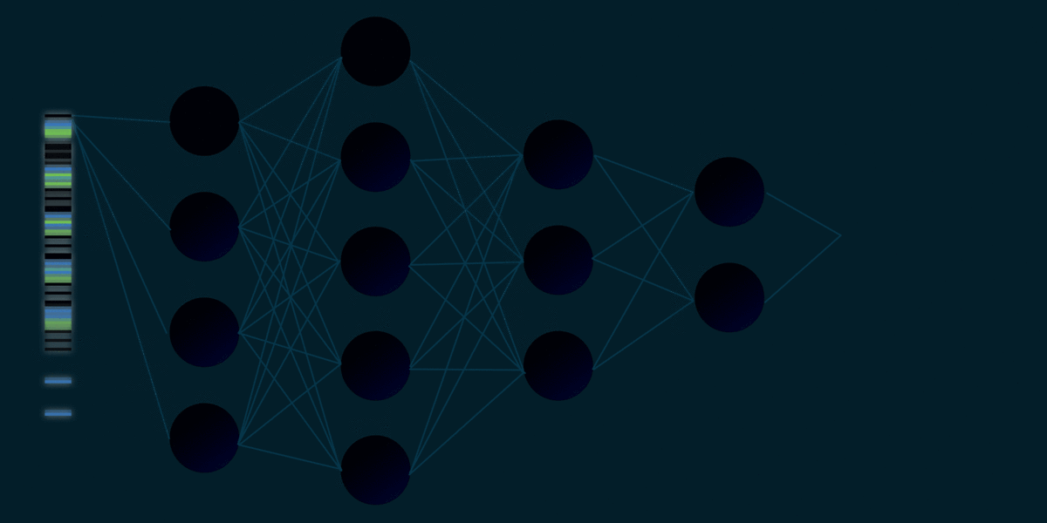
Neural Network
Notes:
This is a nice visualisation that Elvis made for us. On the left, we see the image being the input to the network, and the output is the action we should take in the given state.

Slide 34
Overview
Introduction
Tabular Q-Learning
Deep Q-Learning
Intermediate Results
Further Work

Slide 35
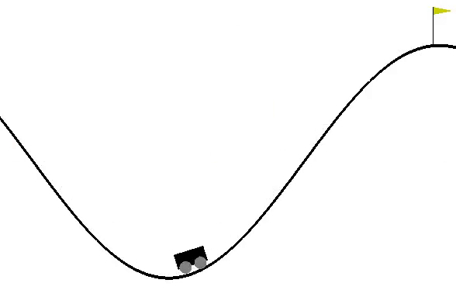
Tabular Q-Learning
Successfully trained simple games such as Cart Pole and Mountain Car
Gained a better understanding of reinforcement learning algorithms
Sensitive to discretization
Sensitive to hyperparameter tuning
This was particularly challenging in the Mountain Car game
Negative reward function
Notes:
Tabular Q -learning used to train simple games like mountain car and cart pole
Helped us gain a better understanding of algorithm
found that Q-Learning was pretty sensitive to parameters. For example, changing the way that the state space was discretized could cause the algorithm to fail.
Also explored various parameters
Mountain Car in particular was challenging because the reward function is negative
the goal is to reach the flag as quickly as possible.
The reward function is -1 for each time step. Impossible to have pos reward, only to minimize negative reward
this structure is similar to the car racing game

Slide 36
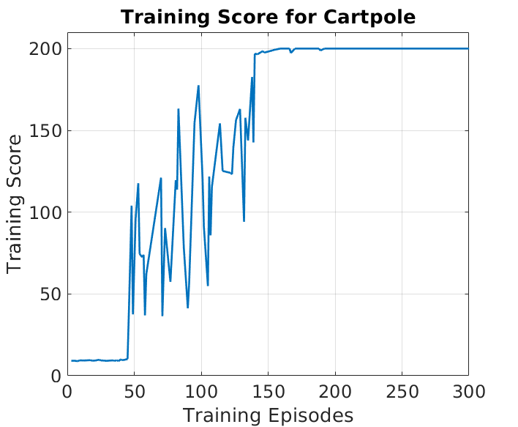
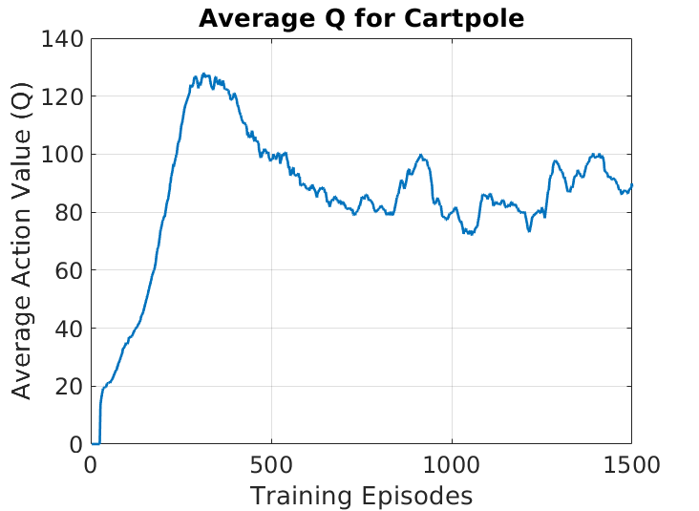
Cartpole (Deep Q-Learning)
Notes:
Next step: implement DQN and train on a simple game like cartpole
Compute an estimate of the average Q value by taking a fixed uniform sample of states, computing the best possible Q value over all actions, and taking the mean
We want average Q to increase as training goes on and eventually converge.
Training score is a noisy measure of performance, so the average Q value is a better way to determine who well our model is learning

Slide 37
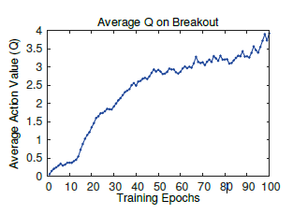
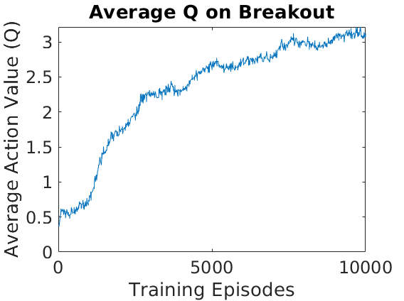
Breakout (Deep Q-Learning)
Average Q value results comparison
Notes:
Need to adjust architecture since we are now dealing with images
Closely followed the process outlined in the Deepmind paper
promising results for the Atari breakout game

Slide 38
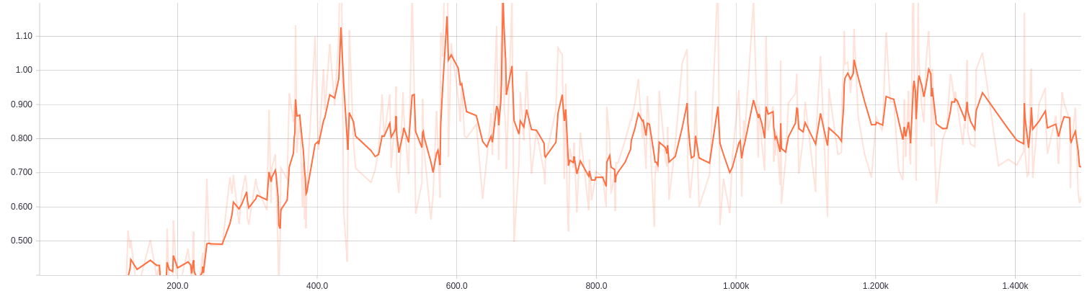
Car Racing (Deep Q-Learning)
Average Q Value
Notes:
We used similar techniques on a car racing game, but our results were not as successful.
We have experimented with different neural network architectures, parameters, image processing, etc but so far we have not seen it learn successfully.
This has been frustrating; however it demonstrates how sensitive this algorithm is.

Slide 39
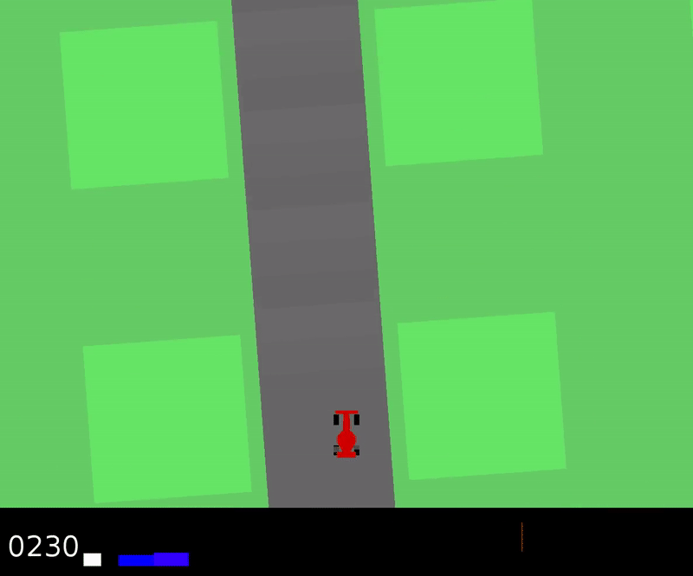
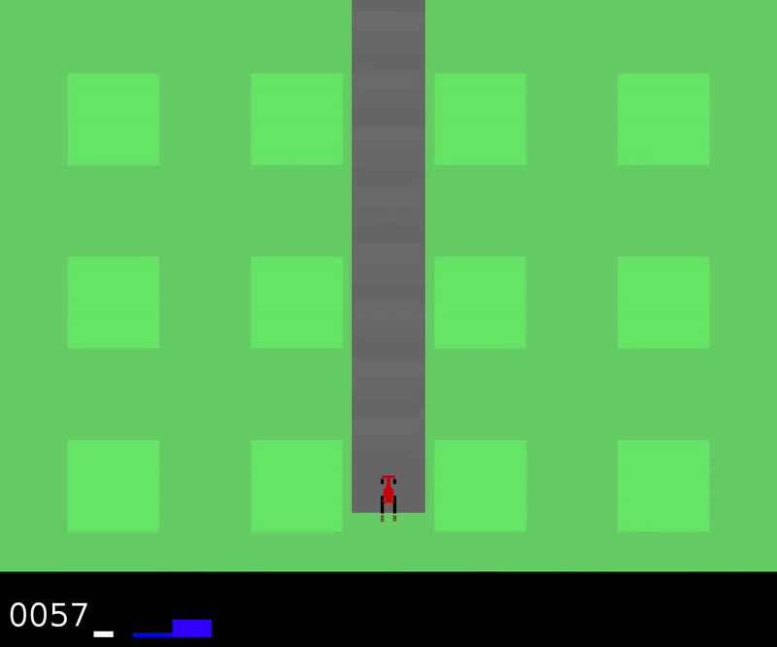
Car Racing with Straight Track (Deep Q-Learning)
At the beginning of training
By the end of training
Notes:
We simplified the Car Racing game to see if our algorithm can learn to go in a straight line.
This is very interesting because it means that In a similar environment, the agent is able to learn a simpler task.
This is something we want to keep in mind as we consider our next steps.

Slide 40
Overview
Introduction
Tabular Q-Learning
Deep Q-Learning
Intermediate Results
Further Work

Slide 41
Further Work
Improve performance in Car Racing environment
Adjusting reward function
Curriculum training
Are these approaches counterintuitive?
Notes:
Curriculum training
Algorithm is able to learn a simple task of going straight within this environment. Can we teach is a slightly more difficult task?
From there, can we teach it to run on a track with one curve? what about a circular track?
We can use curriculum training techniques to give our model *hints* about what it needs to do
Reward function:
Different structure than Atari games
gives a negative reward for each time step.
Perhaps it takes too long to learn a more difficult task
We can adjust reward function to give a higher positive reward for visiting the tiles of the track, or remove time aspect entirely
Prioritized Experience Replay
Instead of uniform sampling for experience replay
Experience replay lets online reinforcement learning agents remember and reuse experiences from the past
Technique developed by deepmind to improve success of dqn algorithm
These approaches may seem counterintuitive since our goal is to generalize
However, they could provide us with an insight about why our algorithm fails, which will motivate our future work

Slide 42
Further Work
Introduce perturbations to environment and analyze performance
Make adjustments to algorithm to make it more robust
Batch Normalization
Regularization
Neural Network Architecture
Notes:
parameters to explore: explore rate, learning rate
Batch Norm
Introduce normalization to the architecture of the neural net
Our hypothesis is that our algorithm is overfitting, which is why its unable to generalize to new environments. Batch Norm is known to act as a regularizer which can help prevent overfitting

Slide 43
Questions?

